Slide 1
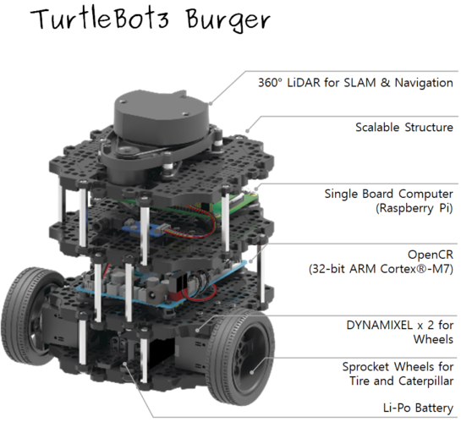
Turtlebot3 Specification
Maximum translational velocity | 0.22 m/s
Maximum rotational velocity | 2.84 rad/s
Maximum payload | 15kg
Size (L x W x H) | 138mm x 178mm x 192mm
Weight (+ SBC + Battery + Sensors) | 1kg

Slide 2
Introduction and Brief History
TurtleBot is a ROS standard platform robot. Turtle is derived from the Turtle robot, which was driven by the educational computer programming language Logo in 1967.
There are 3 versions of the TurtleBot model.
i) TurtleBot1 was developed by Tully and Melonee from Willow Garage in 2010.
ii) In 2012, TurtleBot2 was developed by Yujin Robot.
iii) In 2017, TurtleBot3 was developed.

Slide 3
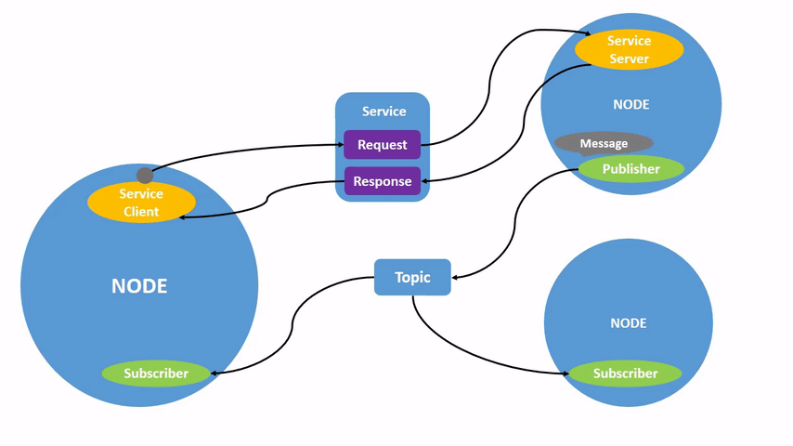
ROS 2 Architecture
Here's a basic overview of the architecture of ROS 2:
Nodes: Nodes are software entities that perform specific tasks or functions within the robotic system.
Nodes communicate with each other by publishing and subscribing to topics.
Each node in ROS should be responsible for a single, modular purpose, e.g. controlling the wheel motors or publishing the sensor data from a laser range-finder.

Slide 4
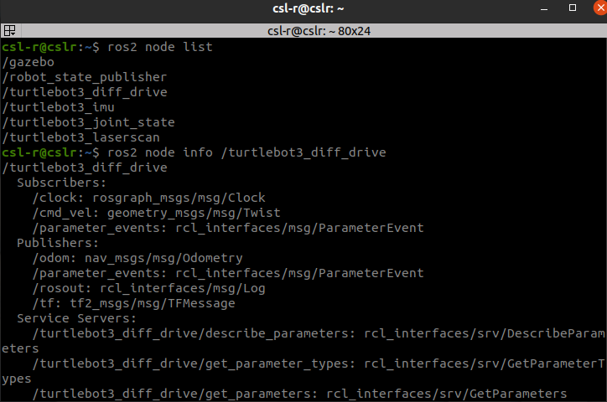
A full robotic system is comprised of many nodes working in concert. In ROS 2, a single executable (C++ program, Python program, etc.) can contain one or more nodes.
We can see about what different types
of nodes running by typing:
ros2 node list in the terminal

Slide 5
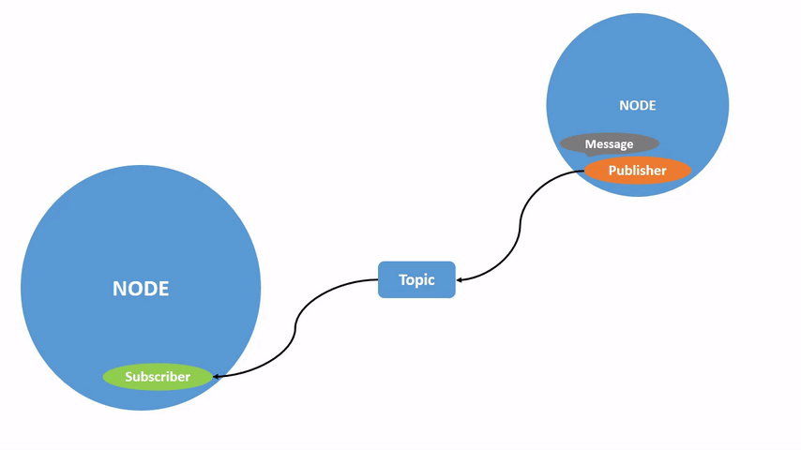
Topics: Topics are a vital element of the ROS graph that act as a bus for nodes to exchange messages(data). A node may publish data to any number of topics and simultaneously have subscriptions to any number of topics.
Topics are one of the main ways in which data is moved between nodes and therefore between different parts of the system.

Slide 6
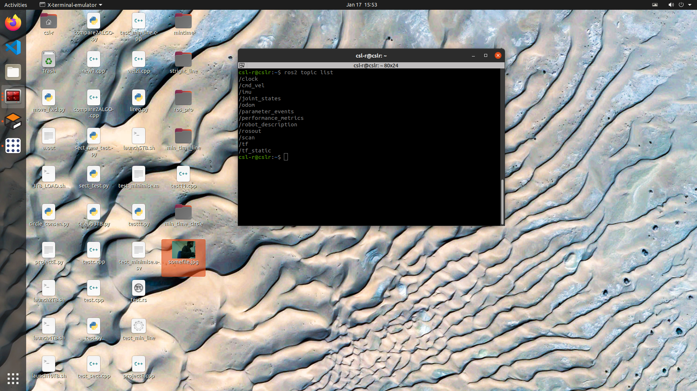
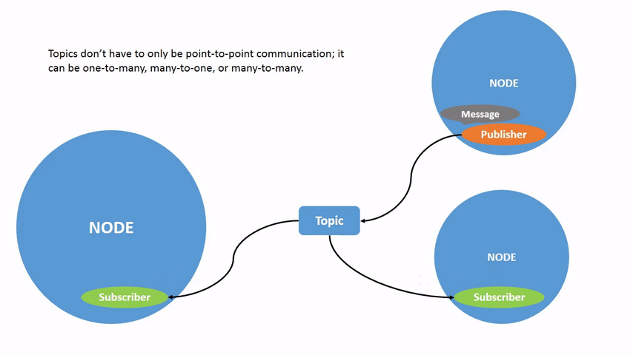
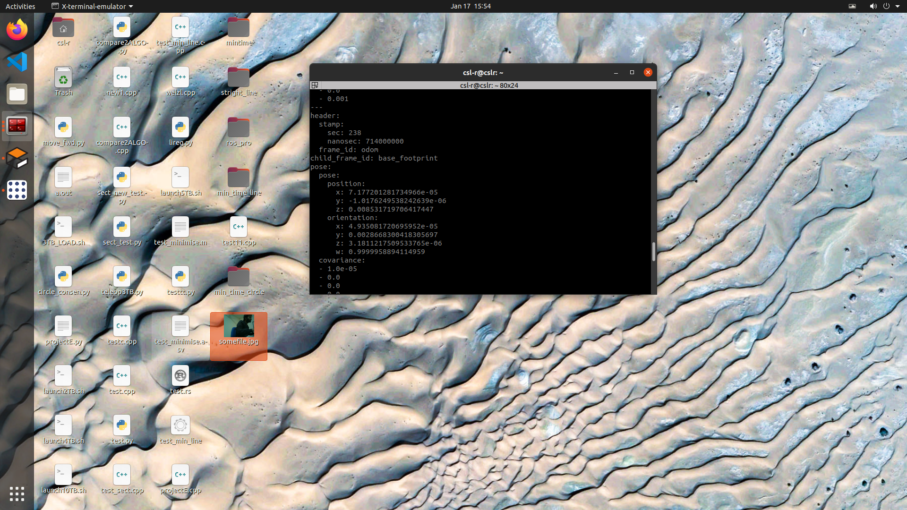
All the topics can be accessed
using command:
ros2 topic list in terminal

Slide 7
RCL (ROS Client Library): ROS 2 uses RCL, a set of low-level libraries that facilitate communication . RCL provides a foundation for the implementation of nodes, messages, and other ROS 2 concepts.

Slide 8
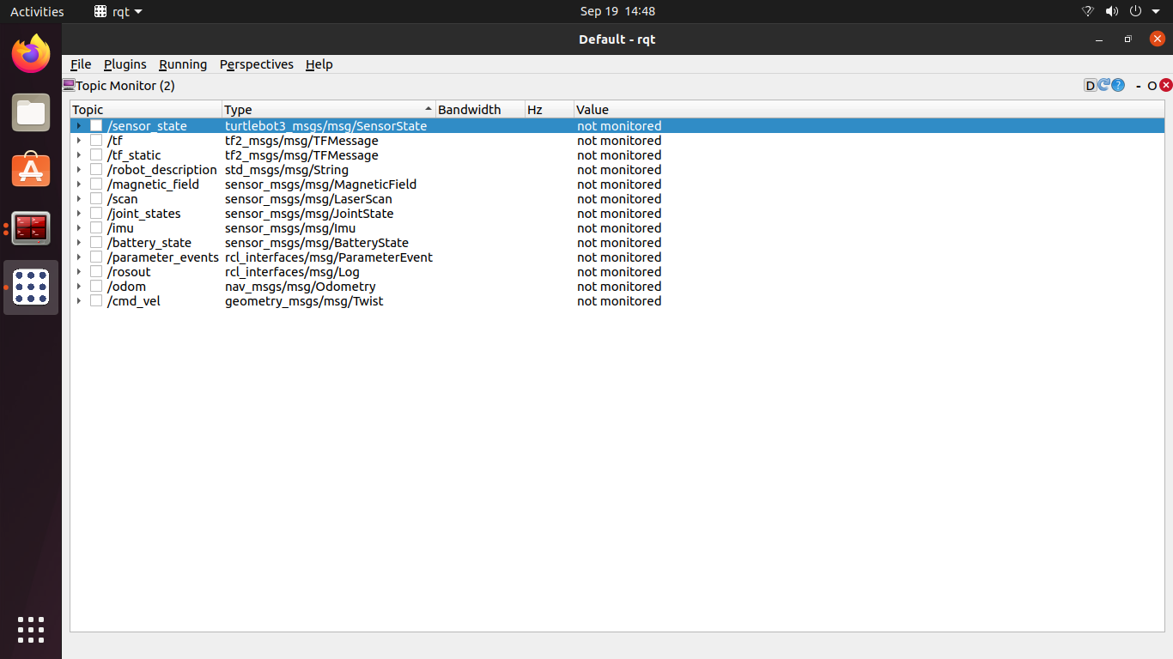
ROS 2 Architecture
Visualization of Nodes and topic in RQT(short for Robot User Interface Toolkit) is a graphical user interface (GUI) framework for ROS, it helps us to visualize the nodes and topic of a robot, in our case the turtlebot3.

Slide 9
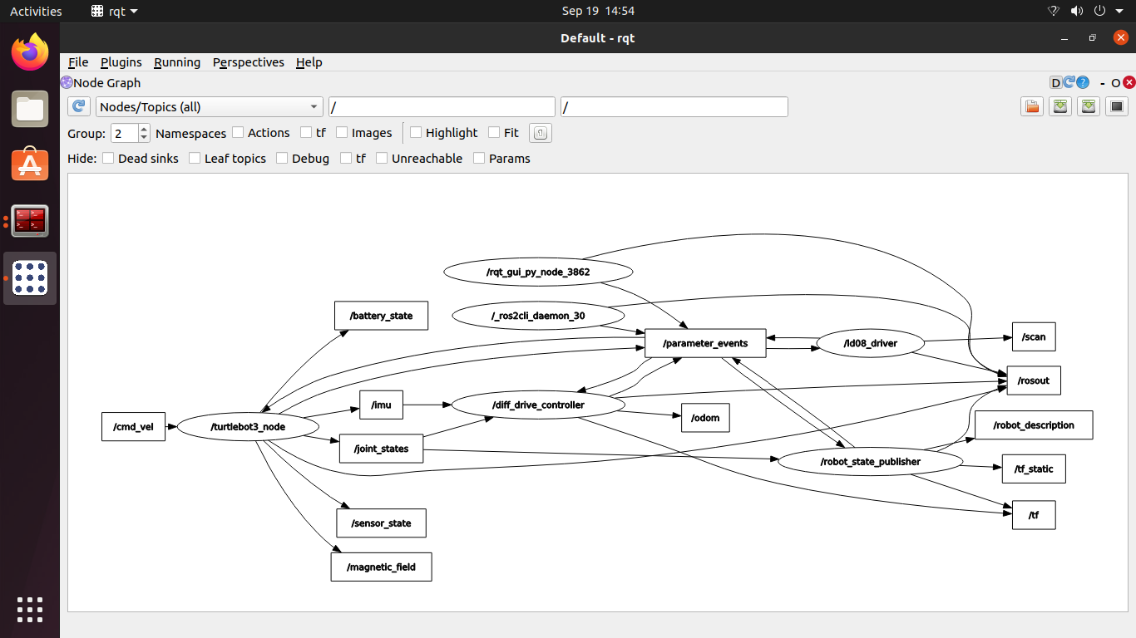
Node graph in RQT
Node graph of single turtlebot3 without the namespace added to both nodes and topics.

Slide 10
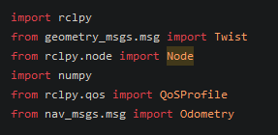
Creating a simple Node to make a bot move
First, we must import few important things before we get started.
rclpy - This line imports the rclpy module, which is the Python client library for ROS 2 . rclpy provides the necessary functionality for creating and managing ROS nodes, publishers, subscribers.
from geometry_msgs.msg import Twist - This line imports the Twist message type from the geometry_msgs.msg module. Twist is a common message type used to represent linear and angular velocities in a 3D space, typically for controlling robot motion.

Slide 11
from rclpy.node import Node - This line imports the Node class from the rclpy.node module. Nodes can publish or subscribe to topics, which are communication channels for sending and receiving messages(via topics).
from rclpy.qos import QoSProfile - This line imports the QoSProfile class from the rclpy.qos module. Quality of Service (QoS) profiles allow you to configure the communication parameters, such as reliability and durability, for ROS topics.
from nav_msgs.msg import Odometry - This line imports the Odometry message type from the nav_msgs.msg module. Odometry messages are commonly used to represent the estimated position(coordinates).

Slide 12
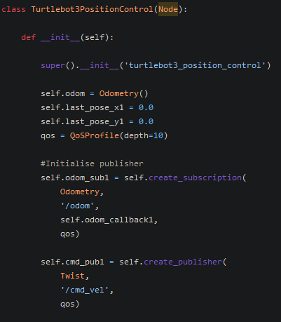
First, we will define a class named Turtlebot3PositionControl that inherits from the Node class provided by the ROS 2 rclpy library. This means that Turtlebot3PositionControl is a ROS node.
In the constructor (__init__ method) of the class, the node is initialized with the name 'turtlebot3_position_control'. The super().__init__ call invokes the constructor of the base class (Node) with the provided name.
These lines initialize some instance variables of the class. self.odom is an instance of the Odometry message type, presumably used to store information about the robot's odometry (position and orientation). self.last_pose_x1 and self.last_pose_y1 are variables used to store the last known position of the robot in the x and y coordinates.

Slide 13
Here, a QoSProfile object is created with a specified depth of 10. This QoS profile is intended for configuring the Quality-of-Service parameters for the communication. It's used when creating subscriptions and publishers later in the code.
Then we will create a subscriber that will subscribe to the '/odom' topic with the Odometry message type. When a message is published on the '/odom' topic, the callback function self.odom_callback1 will be called.
Now we will creates a publisher for sending messages of type Twist to the '/cmd_vel' topic.

Slide 14
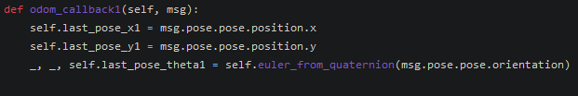
This method (odom_callback1) is a callback function that gets called when a message is received on the '/odom' topic, as specified in the earlier subscription setup. The purpose of this callback seems to be updating the robot's last known position and orientation.
So, every time an odometry message is received, the callback extracts position and orientation information from the message and updates the corresponding variables (self.last_pose_x1, self.last_pose_y1, self.last_pose_theta1).
This creates a timer (self.timer4) associated with the current node. The timer is set to trigger every 0.1 seconds (10 Hz), and it is configured to call the self.same_orien1 method each time it triggers. Timers are often used in ROS nodes to perform periodic tasks.

Slide 15
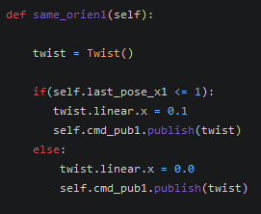
In this code snippet I am creating a function same_orien1 that will make the turtlebot move until self.last_pose_x1 <=1 by publishing the linear velocity twist.linear.x = 0.1 to the bot.
And if self.last_pose_x1 > 1 then I am publishing twist.linear.x = 0 to the robot making it to stop immediately.

Slide 16
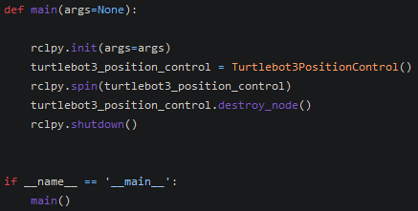
def main(args=None): This function serves as the main entry point for the script.
rclpy.init(args=args): This line initializes the ROS 2 Python client library (rclpy). It sets up the necessary infrastructure for creating and managing ROS nodes.
turtlebot3_position_control = Turtlebot3PositionControl(): This line creates an instance of the Turtlebot3PositionControl class, which is a ROS 2 node for controlling the position of a TurtleBot3 robot.
rclpy.spin(turtlebot3_position_control): This line enters the ROS 2 event loop, allowing the node to continuously listen for and process incoming messages, execute timers. The rclpy.spin function will continue running until the node is shut down.

Slide 17
turtlebot3_position_control.destroy_node(): After the rclpy.spin loop exits (e.g., when the user interrupts the program), this line explicitly destroys the ROS node (turtlebot3_position_control)
rclpy.shutdown(): This line shuts down the ROS 2 client library. It should be called after all ROS-related activities are completed.
if __name__ == '__main__': This conditional statement checks if the script is being run as the main program (not imported as a module).main(): If the script is being run as the main program, the main function is called, initiating the ROS 2 node and entering the event loop.

